Slide 1

THE FOUR IDEOLOGICAL BIAS
-Utkarsh Chaubey (2413094)

Slide 2

Individualism bias
Individualism bias is when individuals think that success or failure is largely a result of individual effort, not external influences such as the economy or government policy. For instance, an individual with this bias may think that a poor individual simply did not work hard enough, without considering factors such as low pay or no job opportunities. This assumption tends to result in less government programs and more individual responsibility in addressing issues.
Notes:
© Copyright Showeet.com – Free PowerPoint Templates

Slide 3

ELITISM BIAS
Elitism bias is the assumption that an elite, privileged minority—usually wealthy, educated, or powerful individuals—are better equipped to make significant choices than the majority. Elitism bias creates the notion that average citizens are not knowledgeable or qualified enough to effectively govern themselves. It may produce policies and leadership that benefit the elite at the expense of the majority. Elitism bias will, in the long run, develop social cleavages, constrain opportunities, and disempower democratic engagement.
Notes:
© Copyright Showeet.com – Free PowerPoint Templates

Slide 4
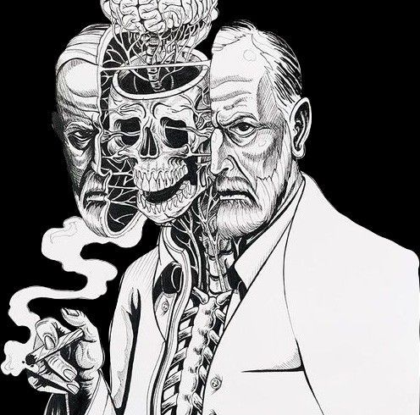
CAPITALISM BIAS
Capitalism bias is when individuals feel that businesses and free markets always produce the best results, and they ignore issues such as low pay, loss of jobs, or harming the environment. They might feel that wealthy individuals are entitled to their riches because they worked harder, even if they inherited their money or had other benefits. Capitalism bias can cause them to favor fewer regulations on businesses and less assistance for financially struggling individuals.

Slide 5

INGROUP BIAS
Ingroup bias is where individuals favor those within their same group—i.e., religion, political affiliation, or community—and view others outside their group as incorrect or dishonest. This has the tendency to make individuals uncritically follow their own group even when they are in the wrong and disparage other groups unfairly. Within politics, ingroup bias produces fragmentation since individuals only want to hear what confirms what they think and shut down alternative views.
Notes:
© Copyright Showeet.com – Free PowerPoint Templates

Slide 6



THANK YOU
.
UTKARSH CHAUBEY
Scholar ID – 2413094

